Slide 1
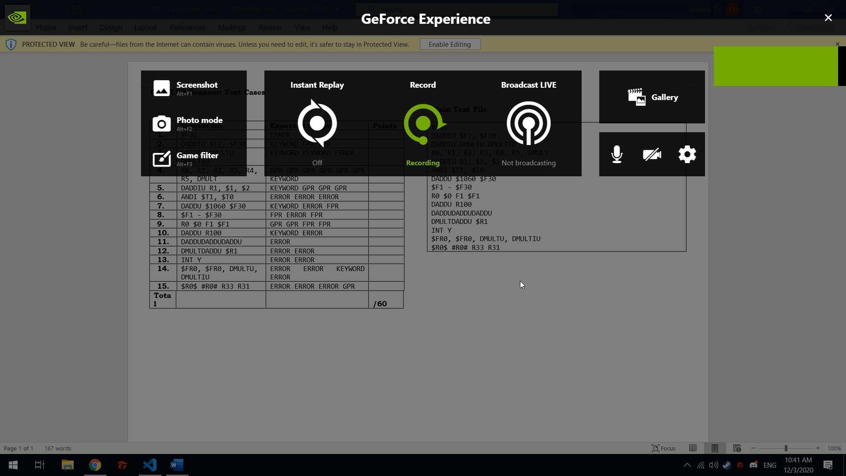
Lenard Balwin L. To S11
Video

Slide 2
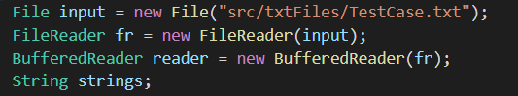
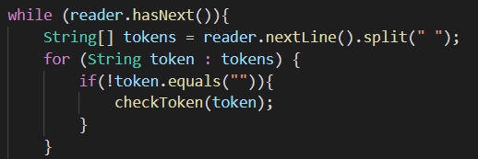
Lexical Analysis
First, I read the input file that contains the sample test cases through a FileReader and BufferedReader
Second, I tokenize each tokens/words by splitting them by whitespaces and by looping through the file line by line

Slide 3
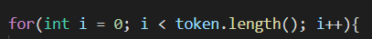
Maximal Munch Algorithm
This algorithm was utilized by forcing the iteration to loop through the string/token fully thus preventing it to have an incorrect verdict. E.g (iterating through DMULTU rather than stopping in DMULT)

Slide 4
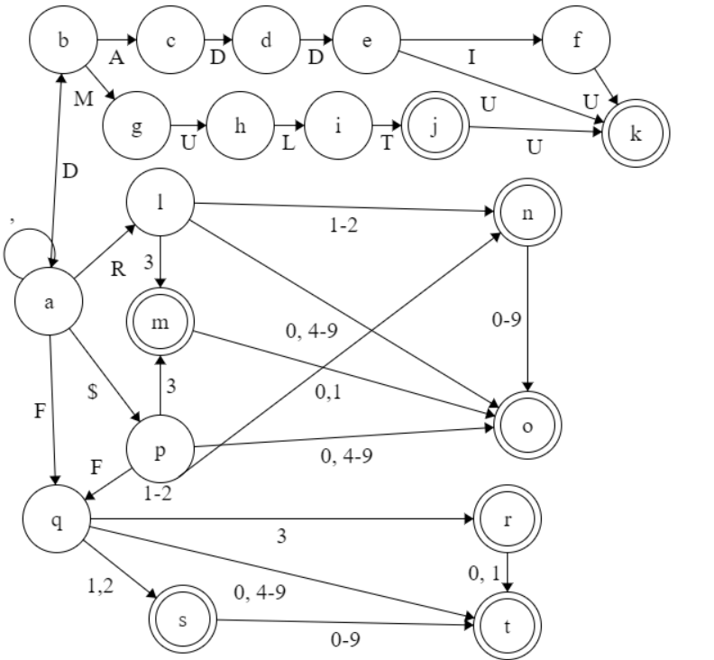
DFA

Slide 5
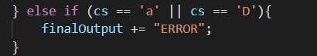
Unrecognizable Tokens
I simply check what the final states is whenever iterating per string/token. So if the final states returns an invalid state (a/D) or a non final state the program would return an “ERROR” keyword

Slide 6
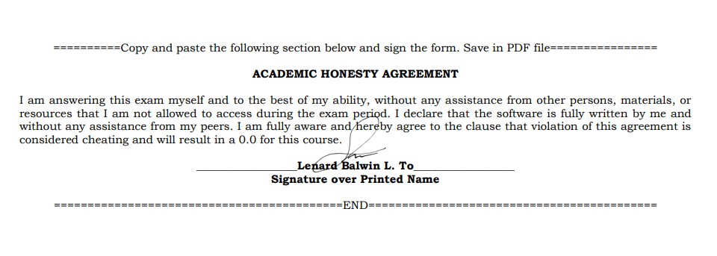
Academic Honesty

Slide 7
FORM and OUTPUT
Input
Output
#F31
DADDIU $F2, $F30
DADDIU DMULTU DMULTIU
R0, R1, R2, R3, R4, R5, DMULT
DADDIU R1, $1, $2
ANDI $T1, $T0
DADDU $1060 $F30
$F1 - $F30
R0 $0 F1 $F1
DADDU R100
DADDUDADDUDADDU
DMULTDADDU $R1
INT Y
$FR0, $FR0, DMULTU, DMULTIU
$R0$ #R0# R33 R31
ERROR
KEYWORD FPR FPR
KEYWORD KEYWORD ERROR
GPR GPR GPR GPR GPR GPR KEYWORD
KEYWORD GPR GPR GPR
ERROR ERROR ERROR
KEYWORD ERROR FPR
FPR ERROR FPR
GPR GPR FPR FPR
KEYWORD ERROR
ERROR
ERROR ERROR
ERROR ERROR
ERROR ERROR KEYWORD ERROR
ERROR ERROR ERROR GPR

